Slide 1
Attention Deficit Hyperactivity Disorder 360$°$ Treatment
www.mentalhealth-pro.com
DR TING SIK CHUEN
Specialist in Psychiatry
Honorary Assistant Professor, Faculty of Medicine, CUHK
Honorary Consultant, Lecturer, HKU SPACE & Hong Kong University of Education
Hong Kong Association for AD/HD
Vice Chairman of Mental Health Foundation
19/10/2019

Slide 2
ADHD 徵狀
Inattention
專注力不足
Hyperactivity
過度活躍
Impulsivity
衝動行為
Notes:
The core symptoms of ADHD as defined in the DSM-IV and ICD-10 diagnostic criteria are inattention, impulsivity and hyperactivity
The differences between these diagnostic criteria will be outlined later.
Video 1: example of ADHA children (3mins)
Video 2: explain power point slide of symptoms of ADHD (5mins)

Slide 3
ADHD 的病徵會隨著年歲增長而改變
圖片來源: Stahl's Essential Psychopharmacology, 3rd Ed. P 844

Slide 4
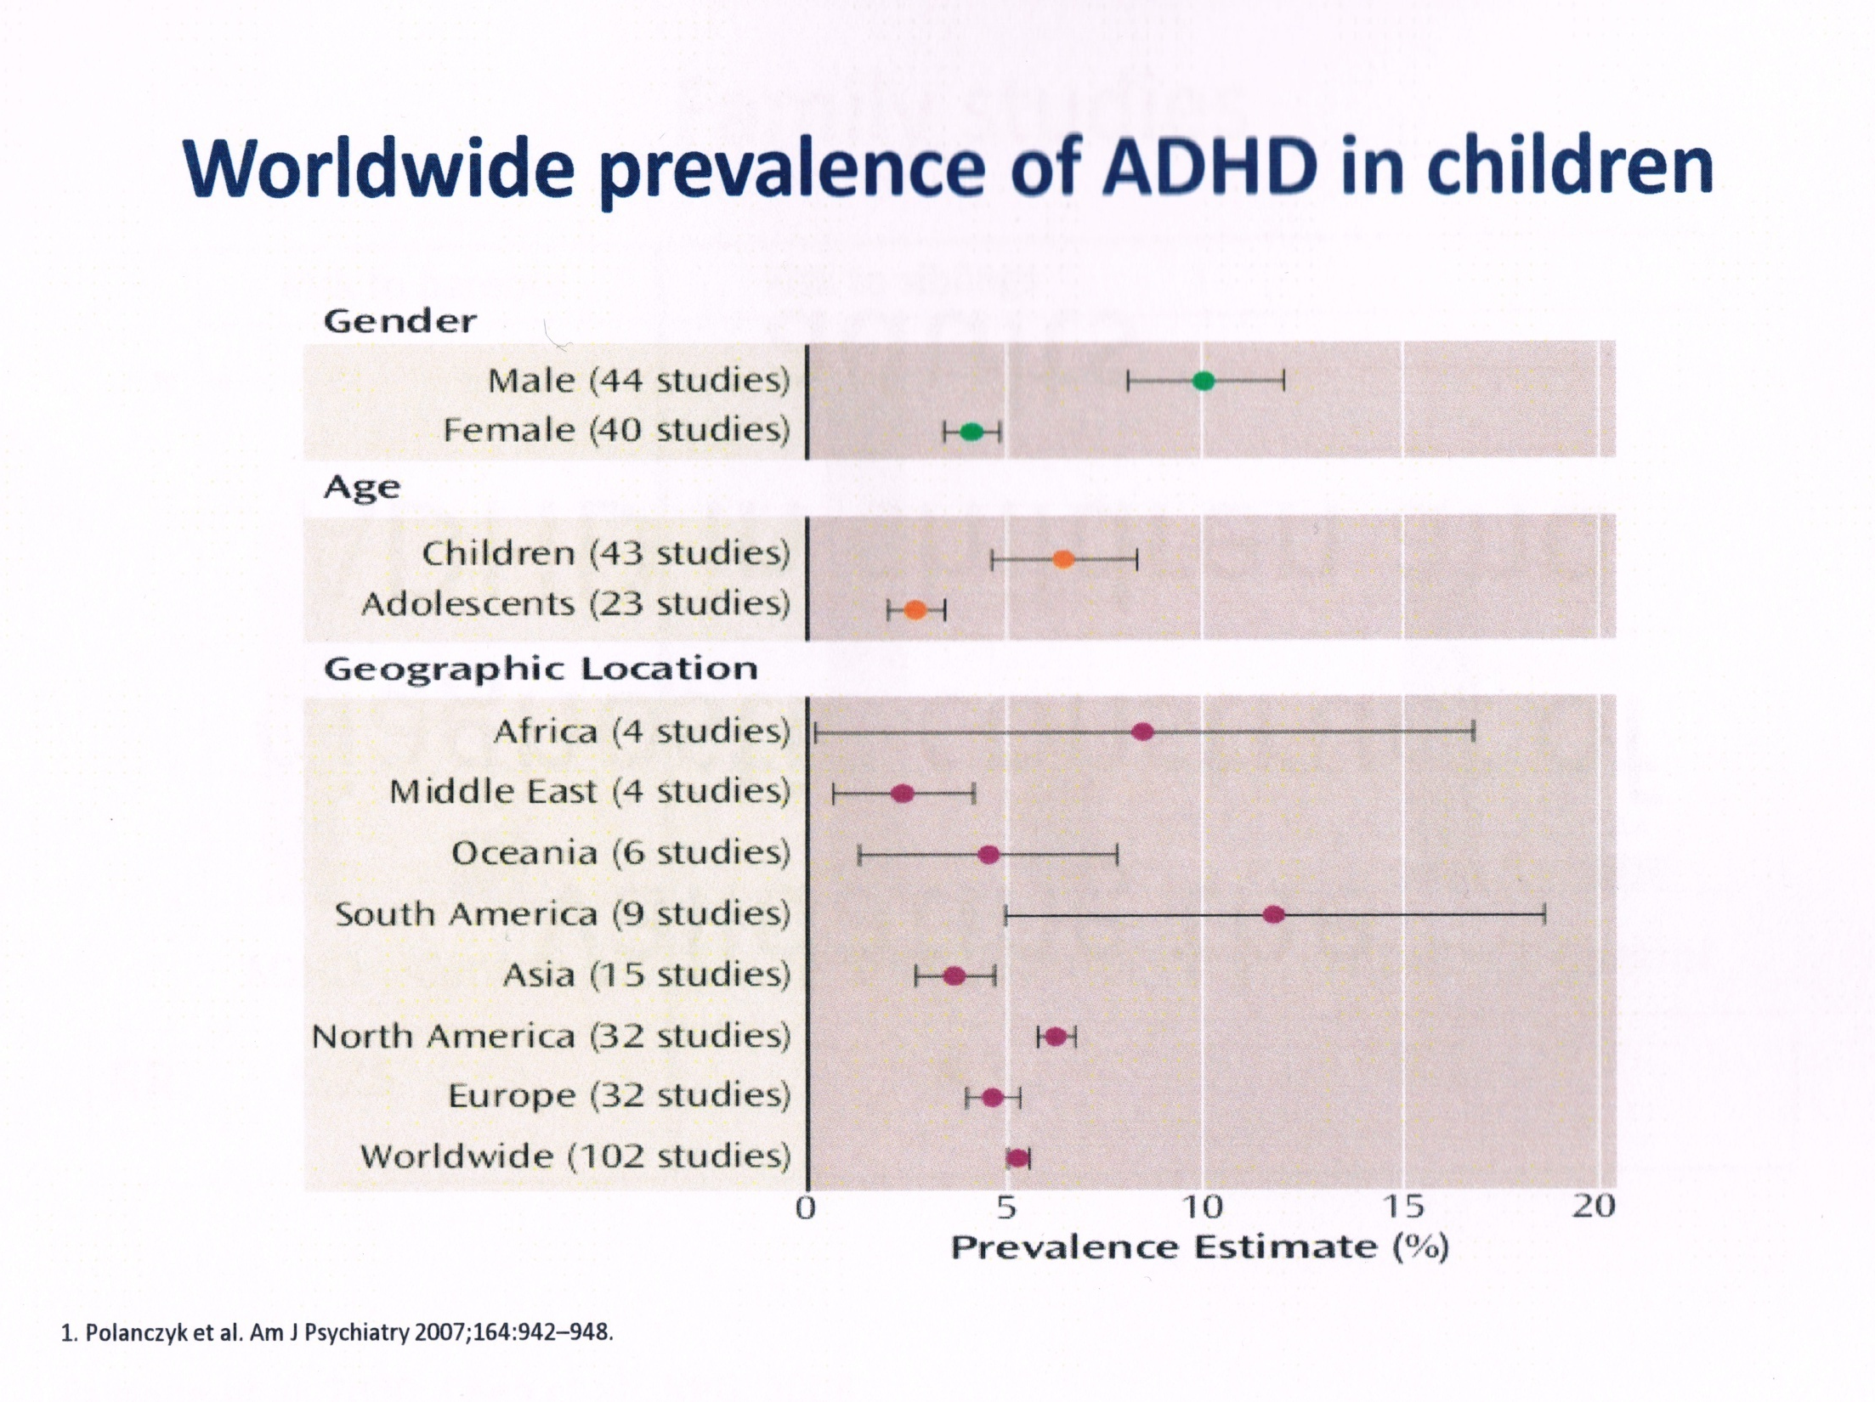
世界各地ADHD發病率

Slide 5
Prevalence of ADHD in HK
6.1% in Primary 1 pupil (3069 pupils in 112 school!), (Luk,SL & Ho,TP 1996)
5.8% in urban mainland China (Shen et al,1985)
3.9% in early adolescence (Ho,TP et al,1998)

Slide 6
Prevalence of ADHD
Worldwide ADHD in children: 3-10% (Biederman and Faraone, 2004; Shastri et al., 2010)
Adult ADHD : 4.4%
M:F : 3 : 1
Association with other problems:
讀寫障礙(Dyslexia) 60%
Conduct/Behaviour 40%
Drug Abuse, Depression, Bipolar Disorder etc

Slide 7
ADHD highly associated with Dyslexia
Dyslexia 10%
ADHD 5%
30%
60%

Slide 8
於孩童出現的多種共有病症 (n=579)
Oppositional
Defiant
Disorder
40%
對抗性行為
Tics
11%
ADD
alone
31%
抽動症
Conduct
Disorder
14%
Anxiety
Disorder
34%
品格障礙
焦慮症
MTA Cooperative
Group. Arch
Gen Psychiatry 1999; 56:1088–1096
Mood Disorders 4%
情緒病
Notes:
Given the high rate of comorbidity with ADHD, a differential diagnosis must exclude coexisting conditions that are symptomatically distinct (e.g. conduct disorder, learning disability, oppositional defiant disorder, Tourette’s disorder, and speech or language disability)¹ and require distinct management.
1. Zametkin AJ, Ernst M. Problems in the management of attention-deficit hyperactivity disorder. N Engl J Med 1999; 340: 40-46.

Slide 9
ADHD: Comorbid Conditions ADHD與共病
60
40
20
0
(%)
Oppositional
defiant
Anxiety
Learning
Mood
Conduct
disorder
Smoking
SUD
Tics
焦慮症
學習
情緒
吸煙
自殺
抽動症
對抗性
行為障礙
品格障礙
Milberger et al. Am J Psychiatry 1995:152:1793–1799
Biederman et al. J Am Acad Child Adolesc Psychiatry 1997;36:21–29
Castellanos. Arch Gen Psychiatry 1999;56:337–338
Goldman et al. JAMA 1998;279:1100–1107
Szatmari et al. J Child Psychol Psychiatry 1989;30:219–230

Slide 11
Outcome of ADHD
Symptoms persist till adulthood 65% (David W et al,2009)
Antisocial Personality Trait 20%
Drug Abuse/Alcoholism 10-40%
Depression/Low Self-esteem
Poor Academic Performance (n=150)
(Repeating Grade) 25%
6. Arrested by Police 7%
Ref: A.KS Lam & TP Ho, 2010. HK Med J Vol 16:4

Slide 12
不同年齡的病徵
 | 3-6歲 | 6-12歲 | 12-18歲 | 18歲或以上
專注不足 | 專注少於三分鐘 不依從活動規則 不聽口頭指令 | 專注少於十分鐘 經常更改主意 善忘, 分心 缺乏組織 | 專注少於30分鐘 操心大意 無條理 馬虎 | 功虧一簣 無前瞻 忘記約會
過動 | 橫衝直撞 | 四維走 | 焦急 | 焦急
衝動 | 不守規則 缺乏危險意識 | 插咀, 插隊 搶答 破壞規矩 危險行為 | 缺乏自制能力 魯莽 喜歡冒險 | 容易發生意外 無耐性 武斷 無深思熟慮 虎頭蛇尾

Slide 13
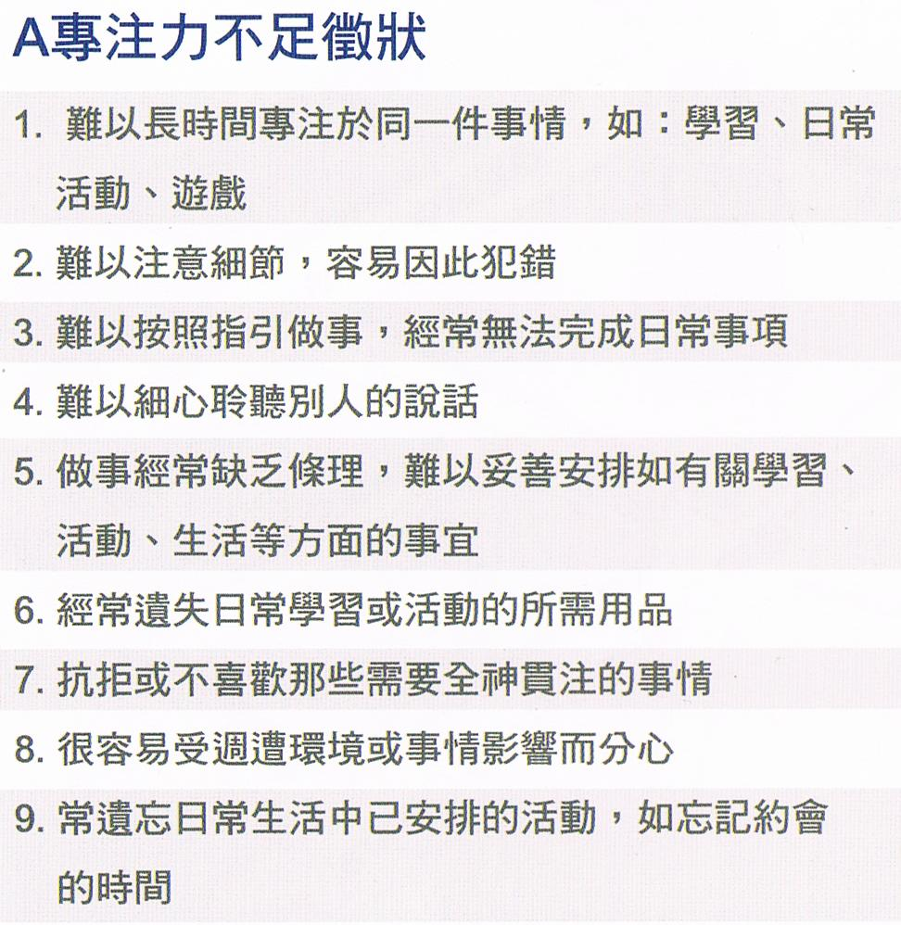
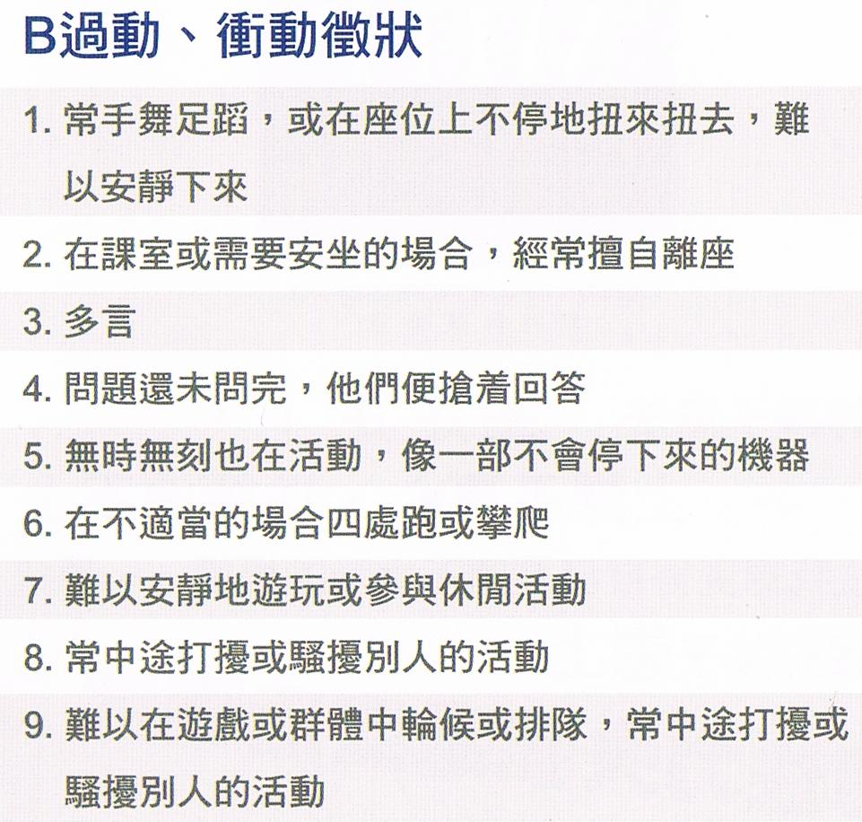
專注力失調/過度活躍症 評估

Slide 14
Symptoms A or B Six or above
Probably has ADHD

Slide 15
美國精神科醫學會DSM-V的臨床診斷標準 注意力不足症狀 (>5)
無法注意到小細節或因粗心大意使學校功課、工作或其他活動發生錯誤。
無法完成老師或家長交辦事務，包括學校課業、家事等。
在工作或遊戲活動中無法持續維持注意力。
和別人說話時，似乎沒在聽。
缺乏組織能力。
常避免、不喜歡或拒絕參與需要持續使用腦力的工作，如：學校工作或家庭作業。
容易遺失或忘了工作或遊戲所需的東西，如：玩具、鉛筆、書等。
容易被外界的刺激所吸引。
容易忘記每日常規活動，需大人時常提醒。

Slide 16
美國精神科醫學會DSM-V的臨床診斷標準 過動/ 衝動症狀(>5)
在座位上無法安靜的坐著，身體扭來扭去。
無法安靜地參與遊戲及休閒活動。
在課堂中常離座，坐不定。
在教室或活動場合中不恰當地跑、跳及爬高等。
日夜不停地動〈很像發動的馬達〉。
說話多〈經常不間斷地持續說話〉。
問題尚未問完前，便搶先答題。
不能輪流等待〈在需輪流的地方，無法耐心地等待〉。
常中斷或干擾其他人，如：插嘴或打斷別人的遊戲。

Slide 17
美國精神科醫學會DSM-V的臨床診斷標準 (2013)
12 歲前出現專注力不足或過動/衝動症狀
病徵應在以下兩種不同環境同時出現：
學校課堂
家庭環境
公眾場所
影響:
學業/工作
生活
人際關係

Slide 18
其實ADHD 的小朋友都有很多不同的長處
Open-minded
持開放態度
Excitable
時常都興奮
Energetic
充滿活力
Fun to be with
與他們相處很有趣
…他們可以是聰明的
Döpfner et al 2000, 2002
Notes:
Educational intent:
to indicate that children with ADHD may exhibit positive types of behaviour too, helping to compensate for their core symptoms
SPEAKERS’ NOTES
Mention famous sufferers if you wish.

Slide 19
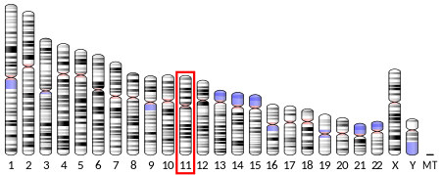
ADHD 的主要成因
基因進化!

Slide 20
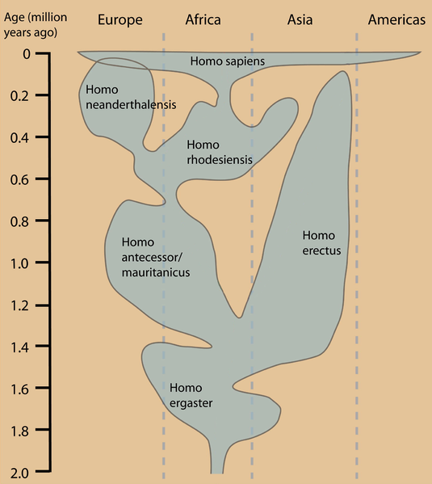
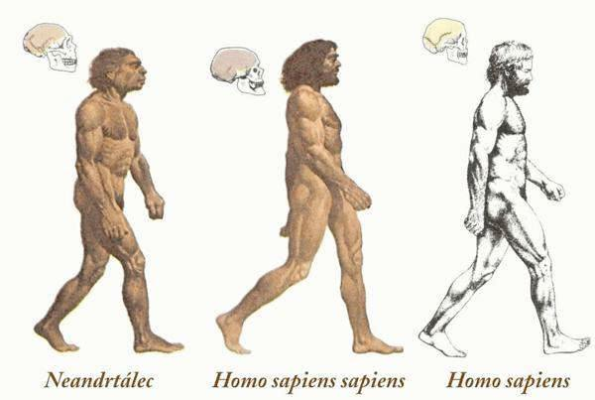
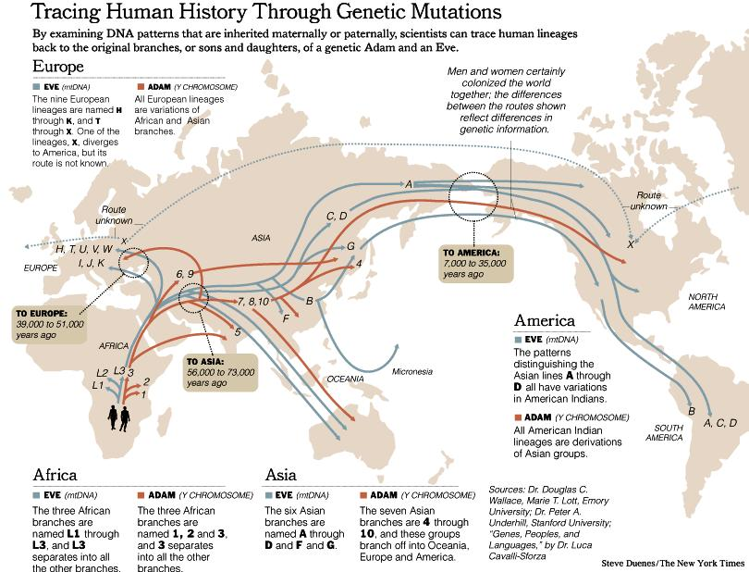
智人
DRD4
尼安德塔人
FOXP2
羅德西亞人
直立人
毛尼坦人
匠人

Slide 21
DRD4 Mutation in Human Evolution (E. Wang, YC Ding, P Flodman et. Al, 2004)
Human dopamine receptor D4 (DRD4) gene is closely related to human exploratory 冒險基因
Gene mutation was estimated between 40000 to 50000 years.四萬至五萬年前基因出現突變
t = [1/In(1 – c)] In [(x(t) – y)/(1 – y)]
t: alle age; c: recombination rate;
X(t): Hz in generation t; y: Hz on ancestral chromosome

Slide 22
突變地點-阿拉伯半島

Slide 23
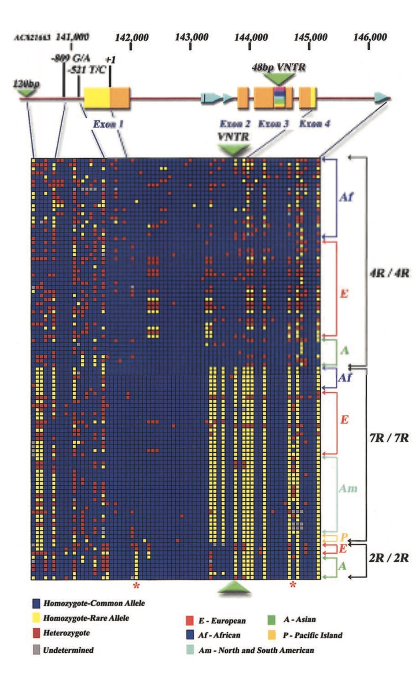
DRD4 基因

Slide 24
HK Study on DRD4 Gene (Patrick Leung et al., 2017)
Low prevalence of DDR4 7R in Chinese (Taiwan, 2005; China, 2004, 2005, 2006, 2007)
33 ADHD and their parents with good response to Methylphenidate
Significantly high preferential transmission of the 2R allele in Chinese ADHD & their parents
2R is the mild manifestation of ADHD than 7R
香港基因研究發現了亞洲DRD4-2R基因 (11p15.5)

Slide 25
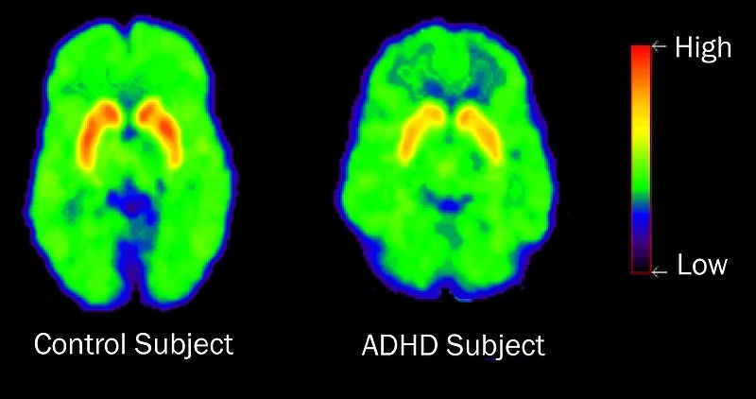
Neurotransmitter Disorder (Dopamine)

Slide 26
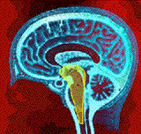
Hypo-arousal in brain (Reticular Activating System)

Slide 27
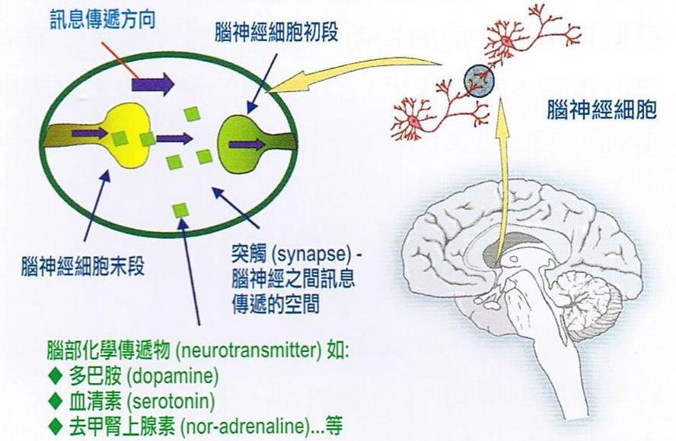
Neuro-chemical Deficit

Slide 29
Executive Function Deficit
Proposed by Dr Russell Barkley in 1997
Review by Willcut in a meta-analysis of 83 studies in 2005 (N = 3734)
The Behavior Rating Inventory of Executive Function (BRIEF) evaluate eight domains of executive functioning(Gioia et al. 2000).
Inhibition, shifting (i.e., moving freely from one thing to another),
emotional control, initiation (i.e., beginning a task),
working memory, planning/organizing,
organizing materials, and monitoring (i.e., checking work)

Slide 30
Executive Function Deficit (Frontal Lobe Deficit)
Poor working memory (Unable to hold information for further processing)短期記憶障礙
Poor organization of thoughts, time and space組織能力弱
Poor planning and prioritizing不分緩急先後
Poor arousal and activation腦部刺激不足
Poor self-regulation of emotion and control自制能力差
Poor internalization of speech (inner speech)內省力差
Poor inhibition of verbal & non-verbal response不能自制
Unable to retrieve and analyse information不能提取及分析
Unable to follow through the plan & action不能貫徹始終
Poor decision making & problem solving未能有效解決困難

Slide 31
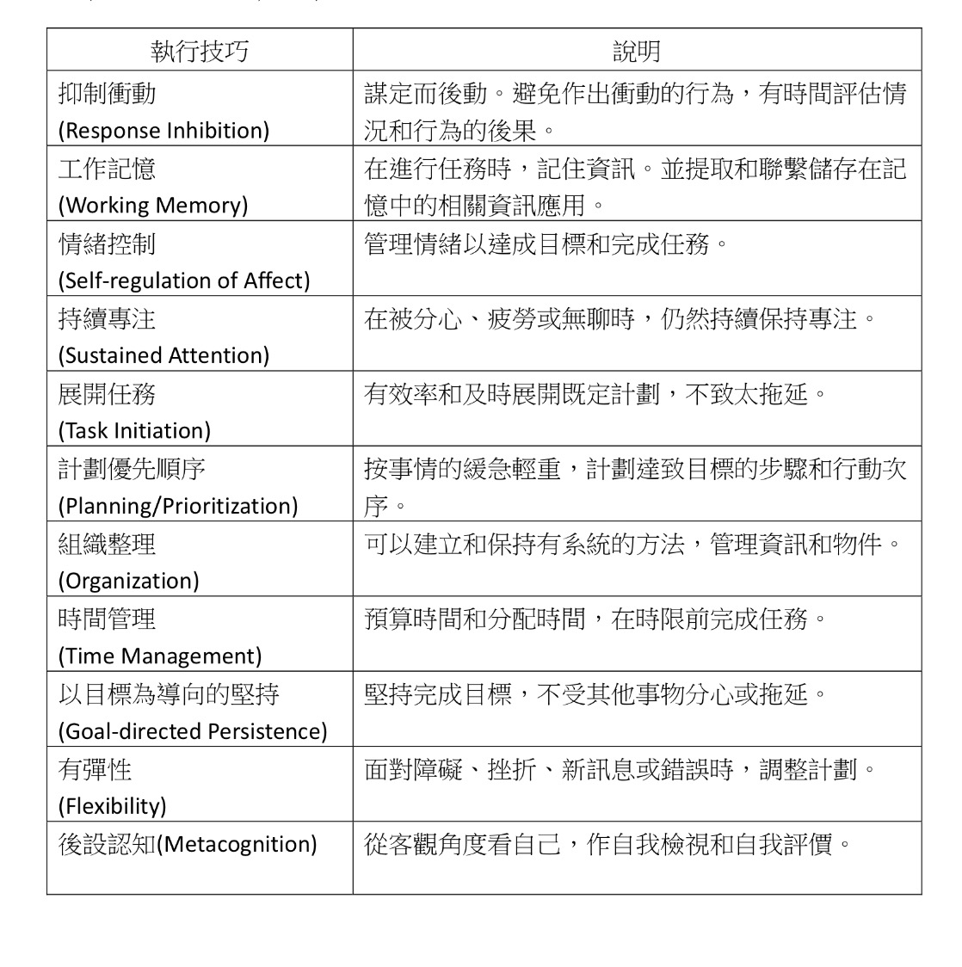

Slide 32
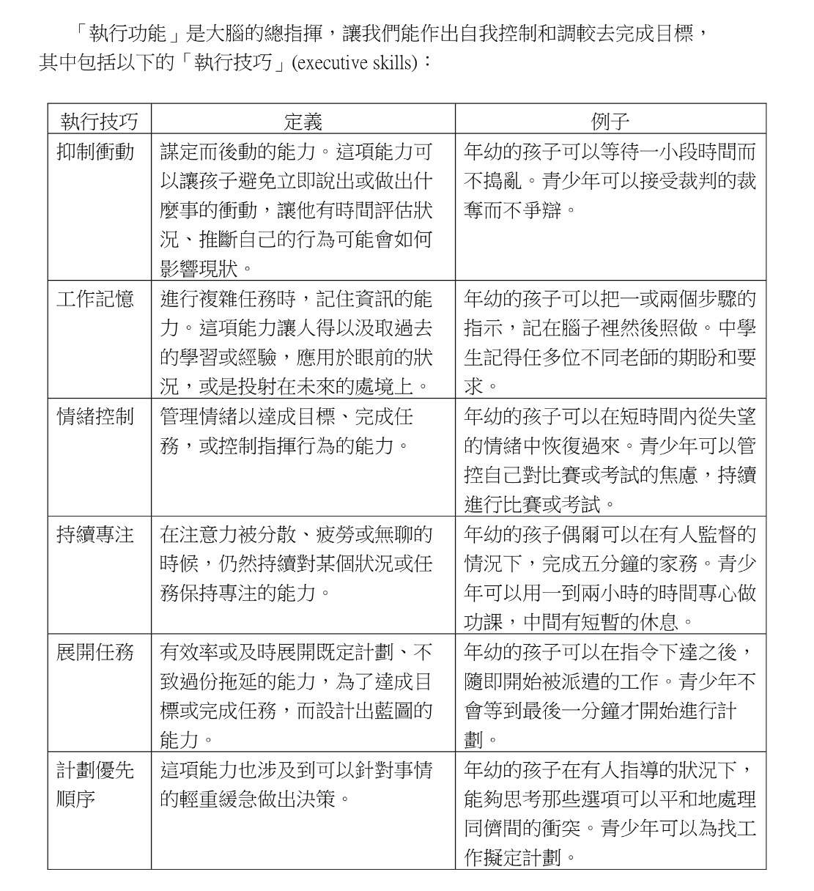

Slide 33
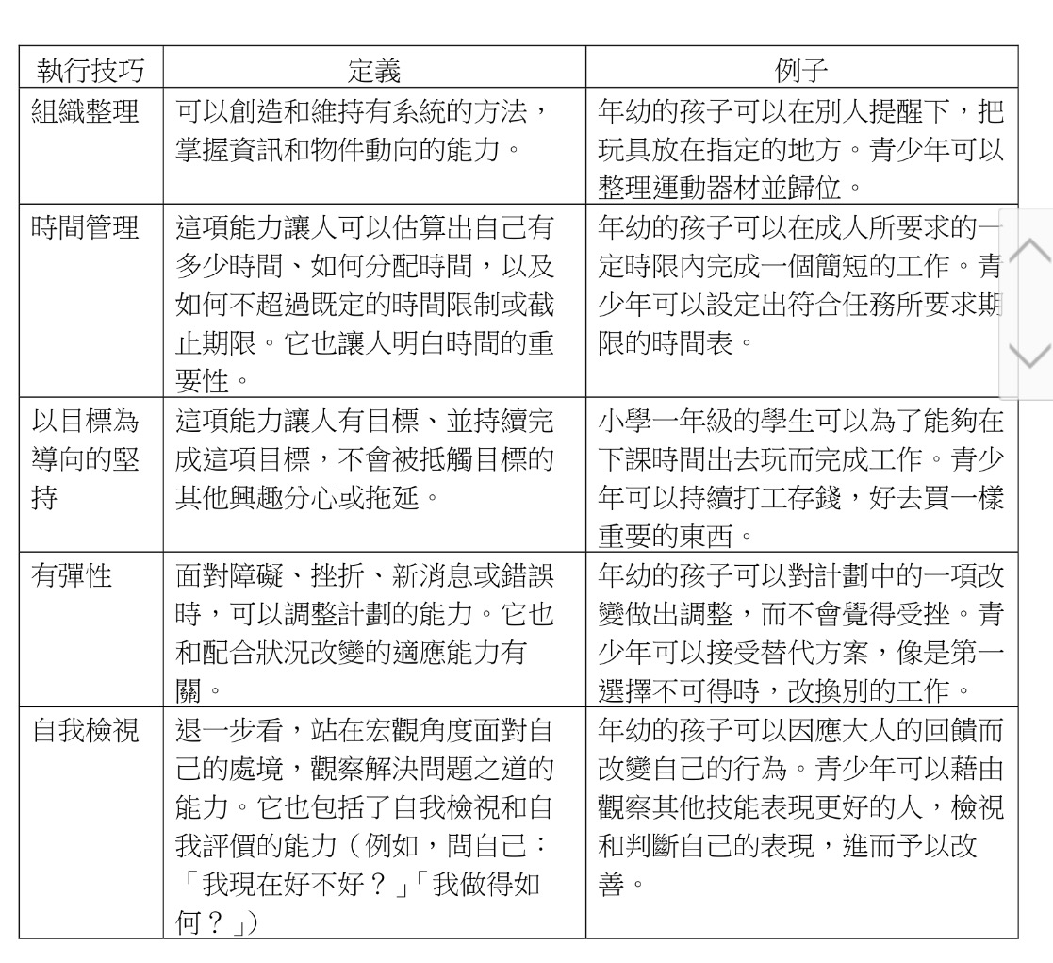

Slide 34
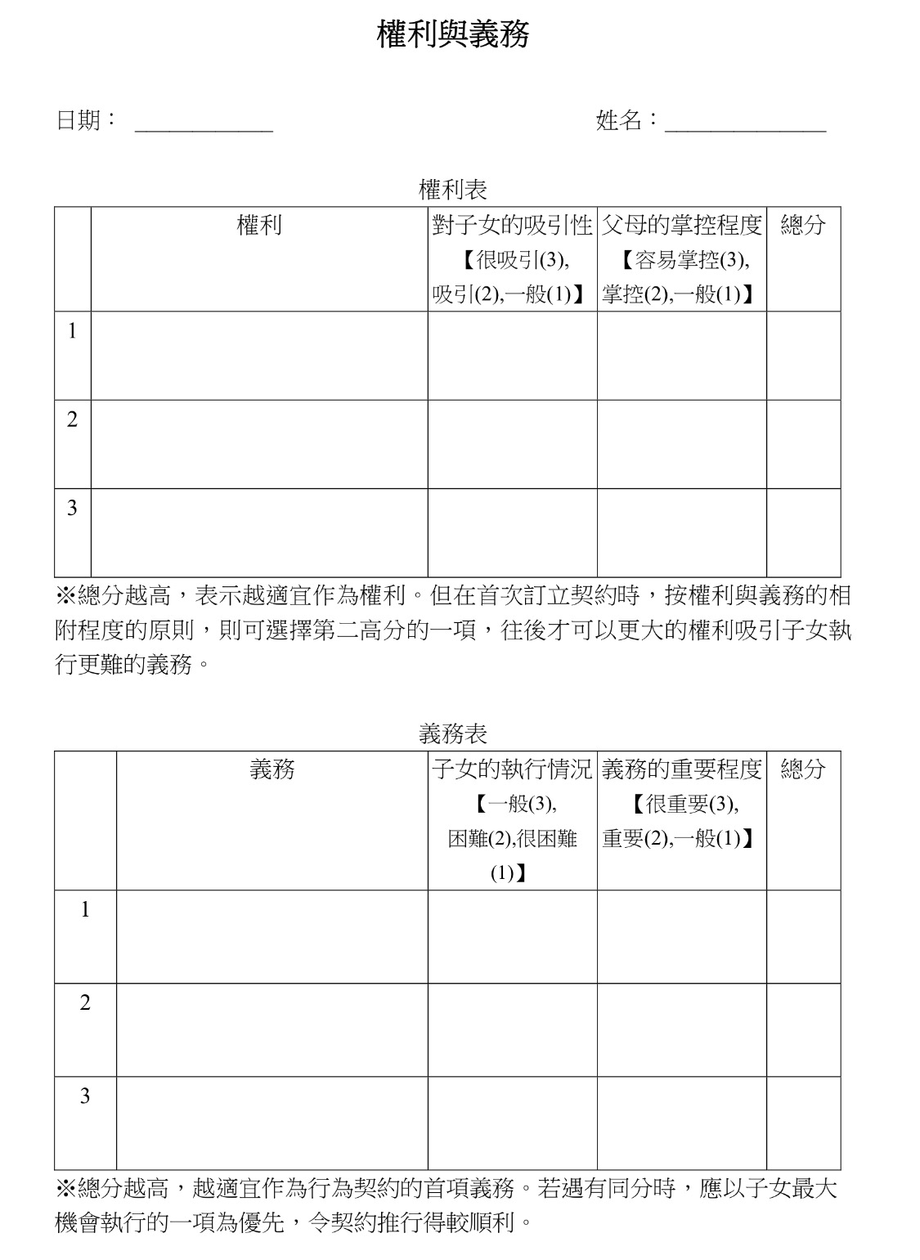
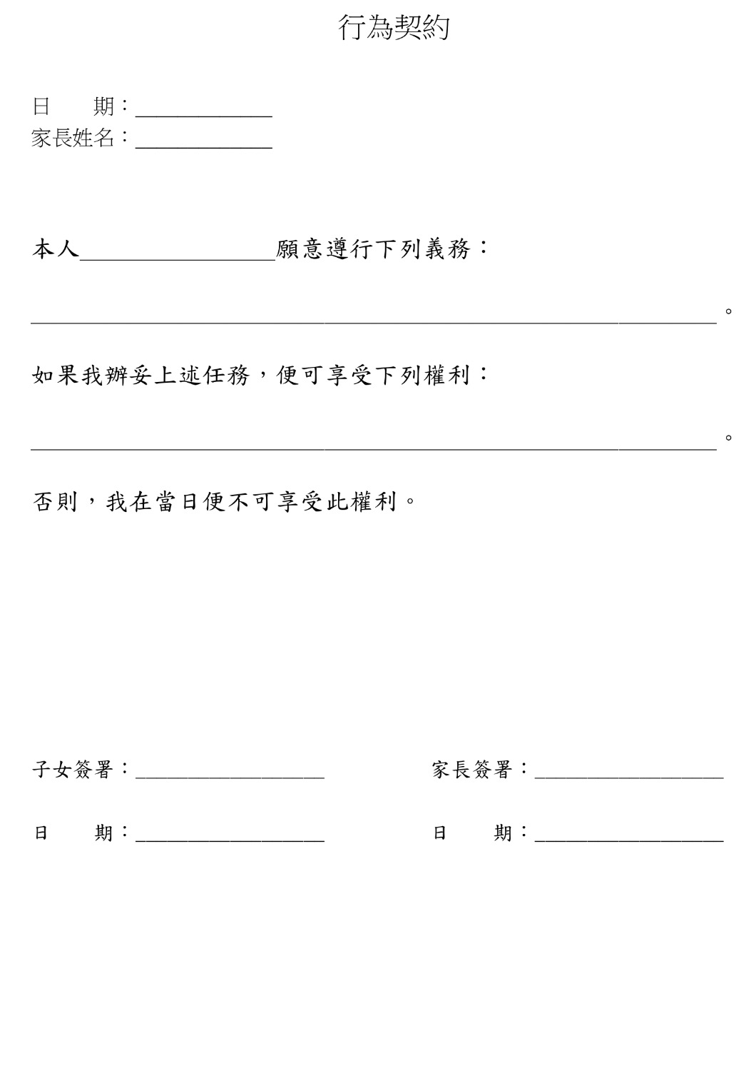

Slide 35
Treatment Algorithm of ADHD
Parent/teacher of child (6-12yr) complaint
NO
Re-assessment
Diagnosis of ADHD
YES
Evaluation of associated conditions
YES
Expert Referral
NO
Non-drug treatment
Remedial Education
Environmental modification
Behavioural therapy
Social skills training
Drug treatment
Ritalin or Ritalin LA or Concerta
Sttrattera
Wellbutrin
Clonidine

Slide 36
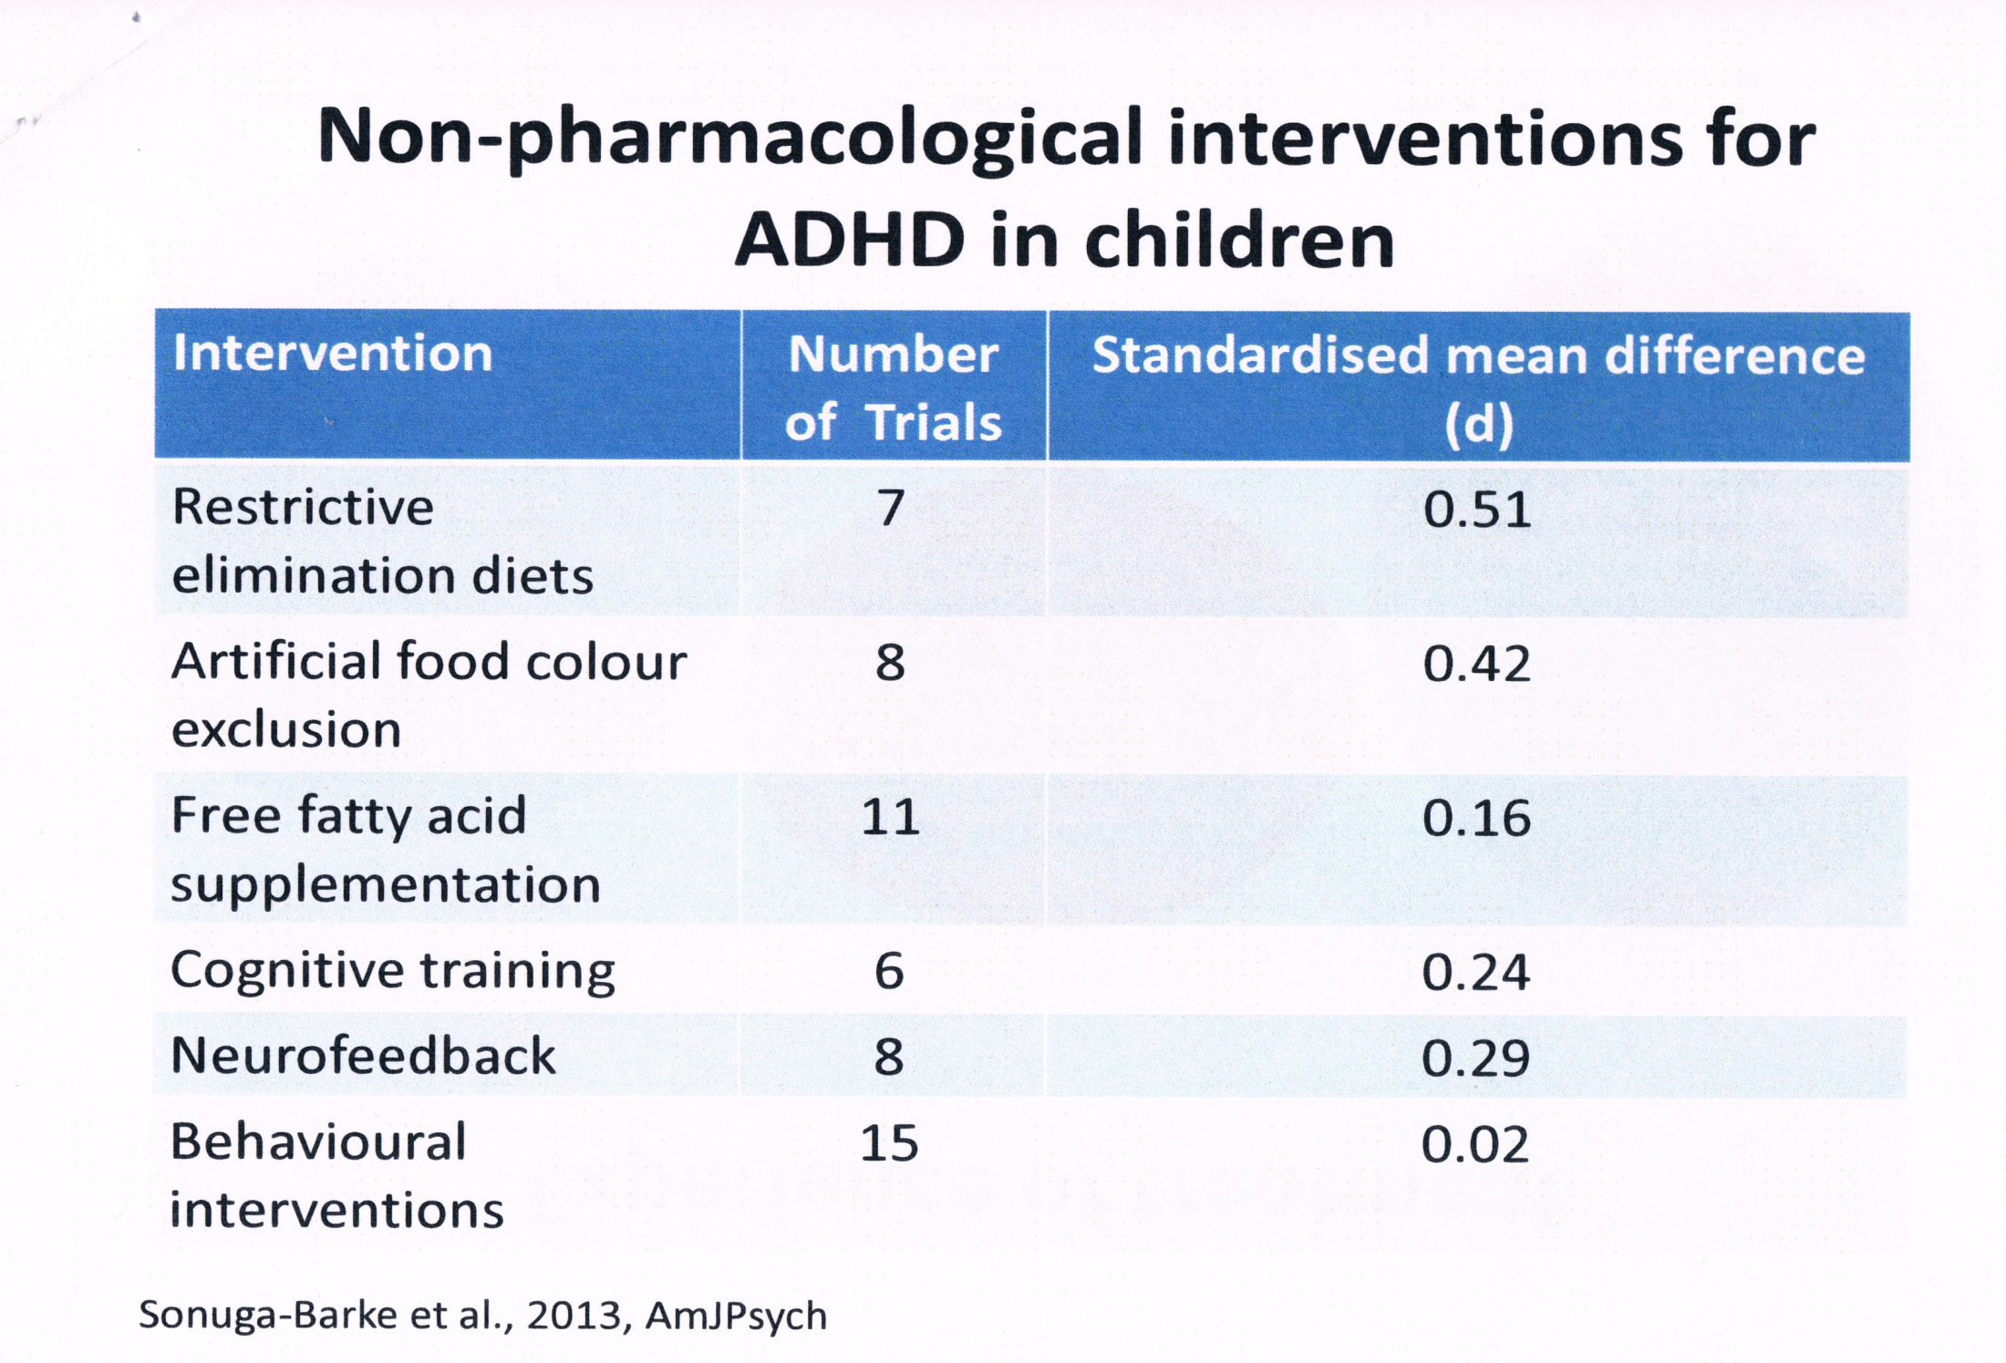

Slide 37
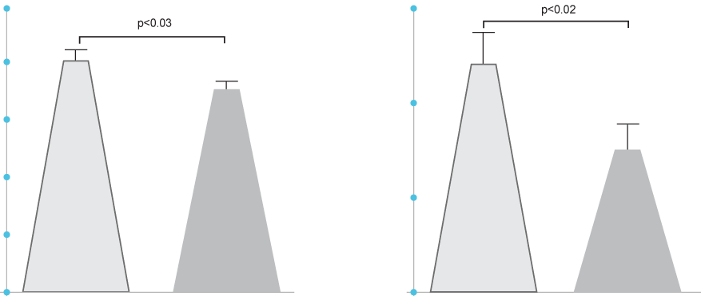
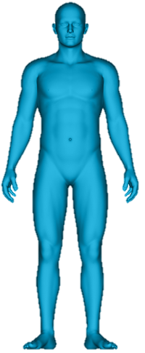
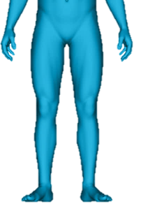
Omega-3 Levels were Significantly Lower ADHD Patients Compared to Healthy Controls
2.5
0.3
Control
ADHD
2.0
% FATTY ACIDS OF PLASMA POLAR LIPIDS
0.2
1.5
1.0
0.1
0.5
0.0
DHA
0.0
EPA
Control n=43
ADHD n=53
Stevens, L.J., et al; Am J Clin Nutr, 1995. 62(4): p. 761-8

Slide 38
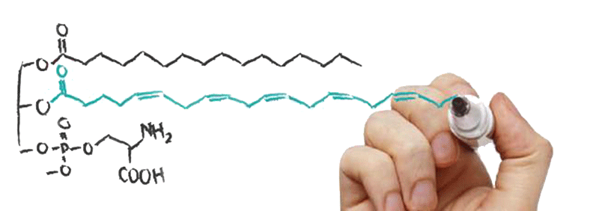
PS-Omega-3- A lipid based innovative product for the clinical dietary management of ADHD
EPA
Serine

Slide 39
The Roles of PS-Omega-3
Regulate Neurotransmitter release
Regulates the cell membrane Fluidity
Forms the cell membrane
Modulates cell survival and cell growth
Regulates cell to cell communication
Increases Omega-3 bioavailability to the brain

Slide 40
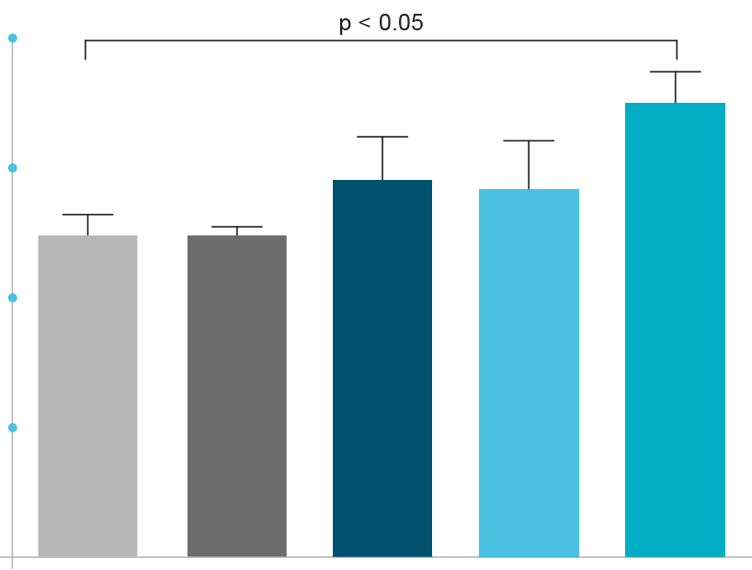
PS-Omega-3 Increases Omega-3 Bioavailability into Brain Tissue
20
15
%Omega-3 of Total Fatty Acids
10
5
0
Control
Soy-PS
Soy-PS + Fish Oil
PS-Omega 3
Fish Oil
* P<0.05 Analysis of variance followed by multiple comparison for each pair
Vaisman, N. et al., Progress in Neuro-Psychopharmacology & Biological Psychiatry, 2009: p. 952-959.

Slide 41
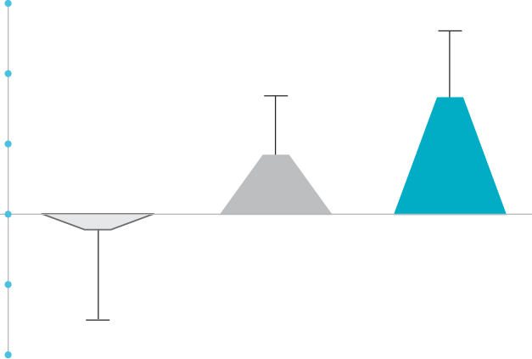
Clinical Evidence
PS-Omega-3 was Clinically Shown to Improve ADHD Symptoms in Children Compared to Omega-3 Fish Oil
6
c
4
b
TOVA SCORE: MEAN CHANGE FROM BASELINE
2
IMPROVEMENT
0
-2
a
-4
PLACEBO n=21
FISH OIL n=22
PS-OMEGA 3 n=18
* Values not sharing a common superscript letter are significantly different, p<0.05
Vaisman, N., et al., m J Clin Nutr, 2008. 87(5): p. 1170-80

Slide 42
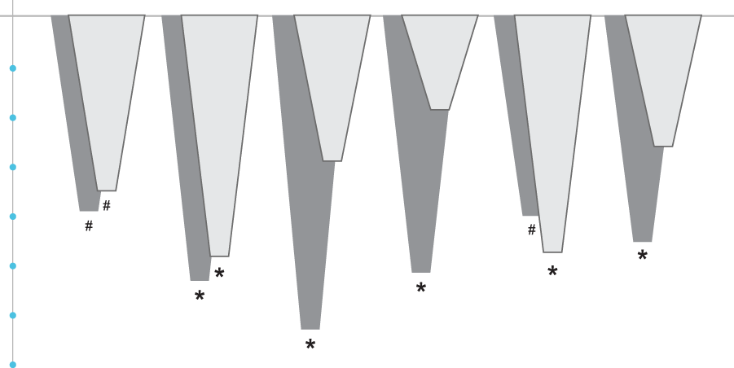
PS-Omega-3 Significantly Improved Several ADHD Symptoms in Hyperactive-Impulsive Children
GLOBAL: RESTLESS/IMPULSIVE
DSM-IV: HYPERACTIVE-IMPULSIVE
HYPERACTIVITY
ADHD-INDEX
DSM-IV: INATTENTIVE
DSM-IV: TOTAL
0
-1
PLACEBO-ADJUSTED CHANGE FROM BASELINE
-2
-3
IMPROVEMENT
-4
-5
-6
CRS-Teachers
-7
CRS-Parents
Results within the subgroup: Children were included in this subgroup if they had an abnormal baseline score (>62) in at least two out of the following CRS-T subscales: Oppositional, Hyperactivity, ADHD-index, or Global: Emotional lability. #p ≤ 0.1 , *p < 0.05, Based on analysis of covariance controlled for gender and age
Manor I., et. al. Eur psychiatry, 2012 Jul;27(5):335-42.

Slide 43
Children who are intolerant to stimulant therapy
Children/parents who are reluctant to start drug therapy
Children with ADHD symptoms
Children with ADHD symptoms
Children with mood and behavior dysregulation
Children with pronounced hyperactive-impulsive behavior
Notes:
Possible question from you to the audience:
Can you think of one (or more than one) patient within your practice who may benefit from Vayarin®?
MAIN POINT: To discuss different patient profiles.

Slide 44
Drug Treatment for ADHD

Slide 45
Direction of nerve signals
Nerve cell
Nerve ending

Slide 46
Treatment of ADHD (Should not use under the age of 6)
Symptoms of ADHD
Attention Deficit
Impulsivity
Hyperactivity
Sedatives鎮靜劑
Mood Stabilizers
Anti-psychotics
CNS Stimulants
中樞神經興奮劑
Mood Stabilizers情緒穩定劑
Anti-depressants抗抑鬱藥
Anti-psychotics抗精神病藥

Slide 47
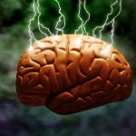
Central Nervous Stimulants
Medications
哌甲酯Methylphenidate (利他能Ritalin) 0.3-1.5mg/kg in 3 divided dose (Last for 4 hours)
Concerta專注達(18mg-54mg/day, last for 8-12 hours)
Ritalin LA (0.3mg-1.5mg/kg (Last for 6-8 hours)
Strattera斯德瑞 (0.5-1.2mg/kg/day, last for 8-12 hours)
Monitoring the weight, height, sleep & appetite
75% improvement in class & academic results

Slide 48
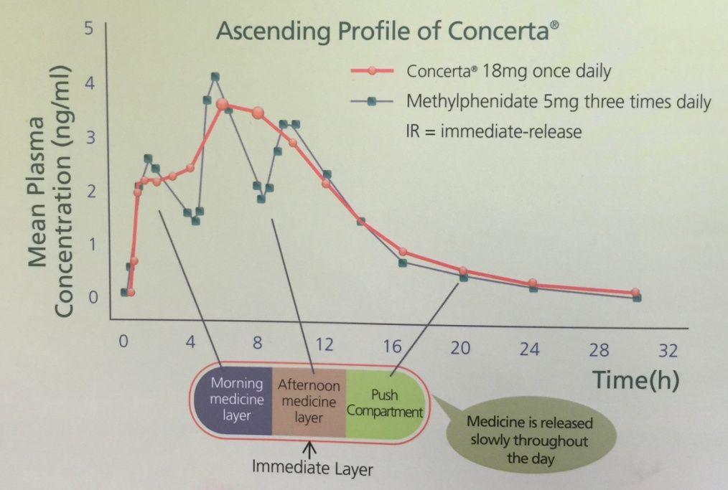
Once daily (10-12 Hours)
Rapid onset
Exaggerate tics
Reduces all symptoms
Well tolerated
Headache (26%)
Loss of appetite (14%)
Insomnia (14%)

Slide 49
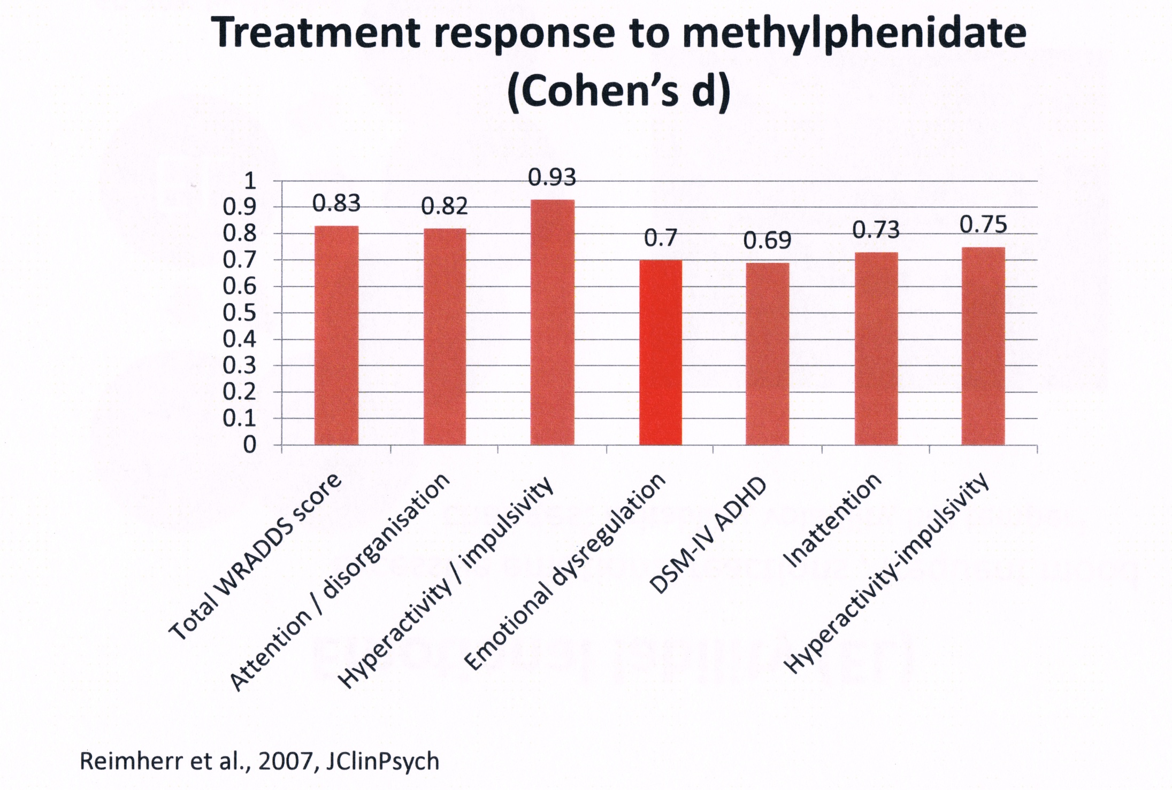

Slide 50
Growth Rate Reduction in Children with ADHD
 | Concerta | Ritalin LA | Ritalin
Studied Period (months) | 21 | 12 | 36
Estimated annual growth rate in height (cm/yr) | -0.13 | -1.38 | -0.67
Estimated annual growth rate in weight (kg/yr) | -0.7 | -1.32 | -0.9

Slide 51
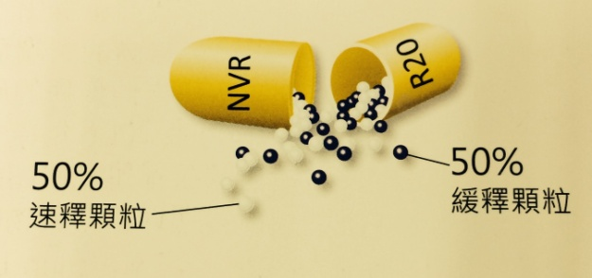
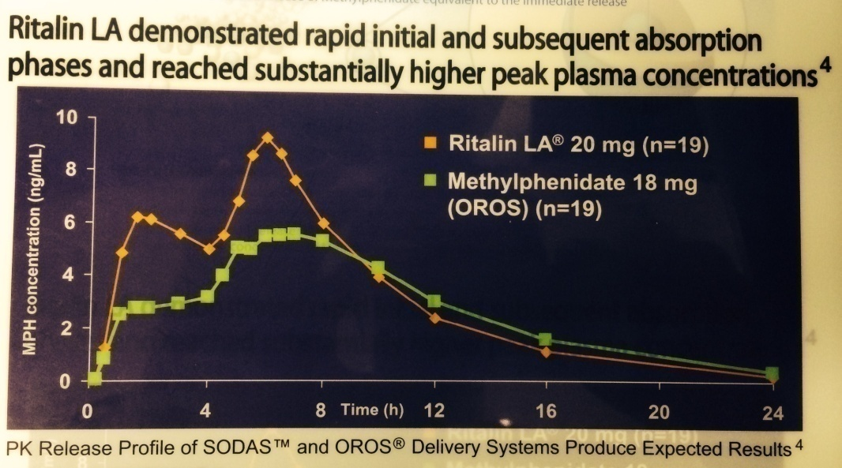
Ritalin LA
Last for 8 hours
Rapid initial phase within one hour
Subsequent absorption phase after four hours
Maximum daily dose = 60mg
Exacerbation of Motor Tics
Ref: Markowitz JS, et al. Clin Pharmacokinet. 2003;42:393-401

Slide 52
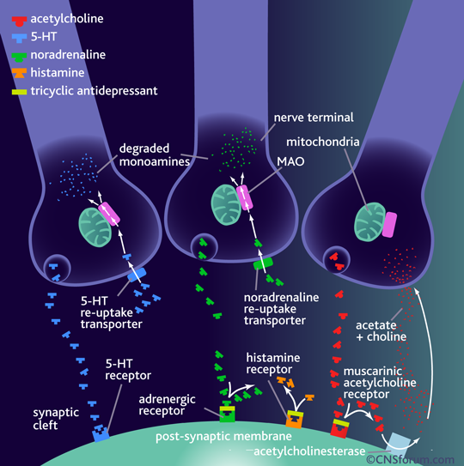
Once or Twice daily
Delay onset
non-stimulant
Improves sleep pattern
Well tolerated
Headache (23.6%)
Loss of appetite (7.1%)
Insomnia (6%)

Slide 53
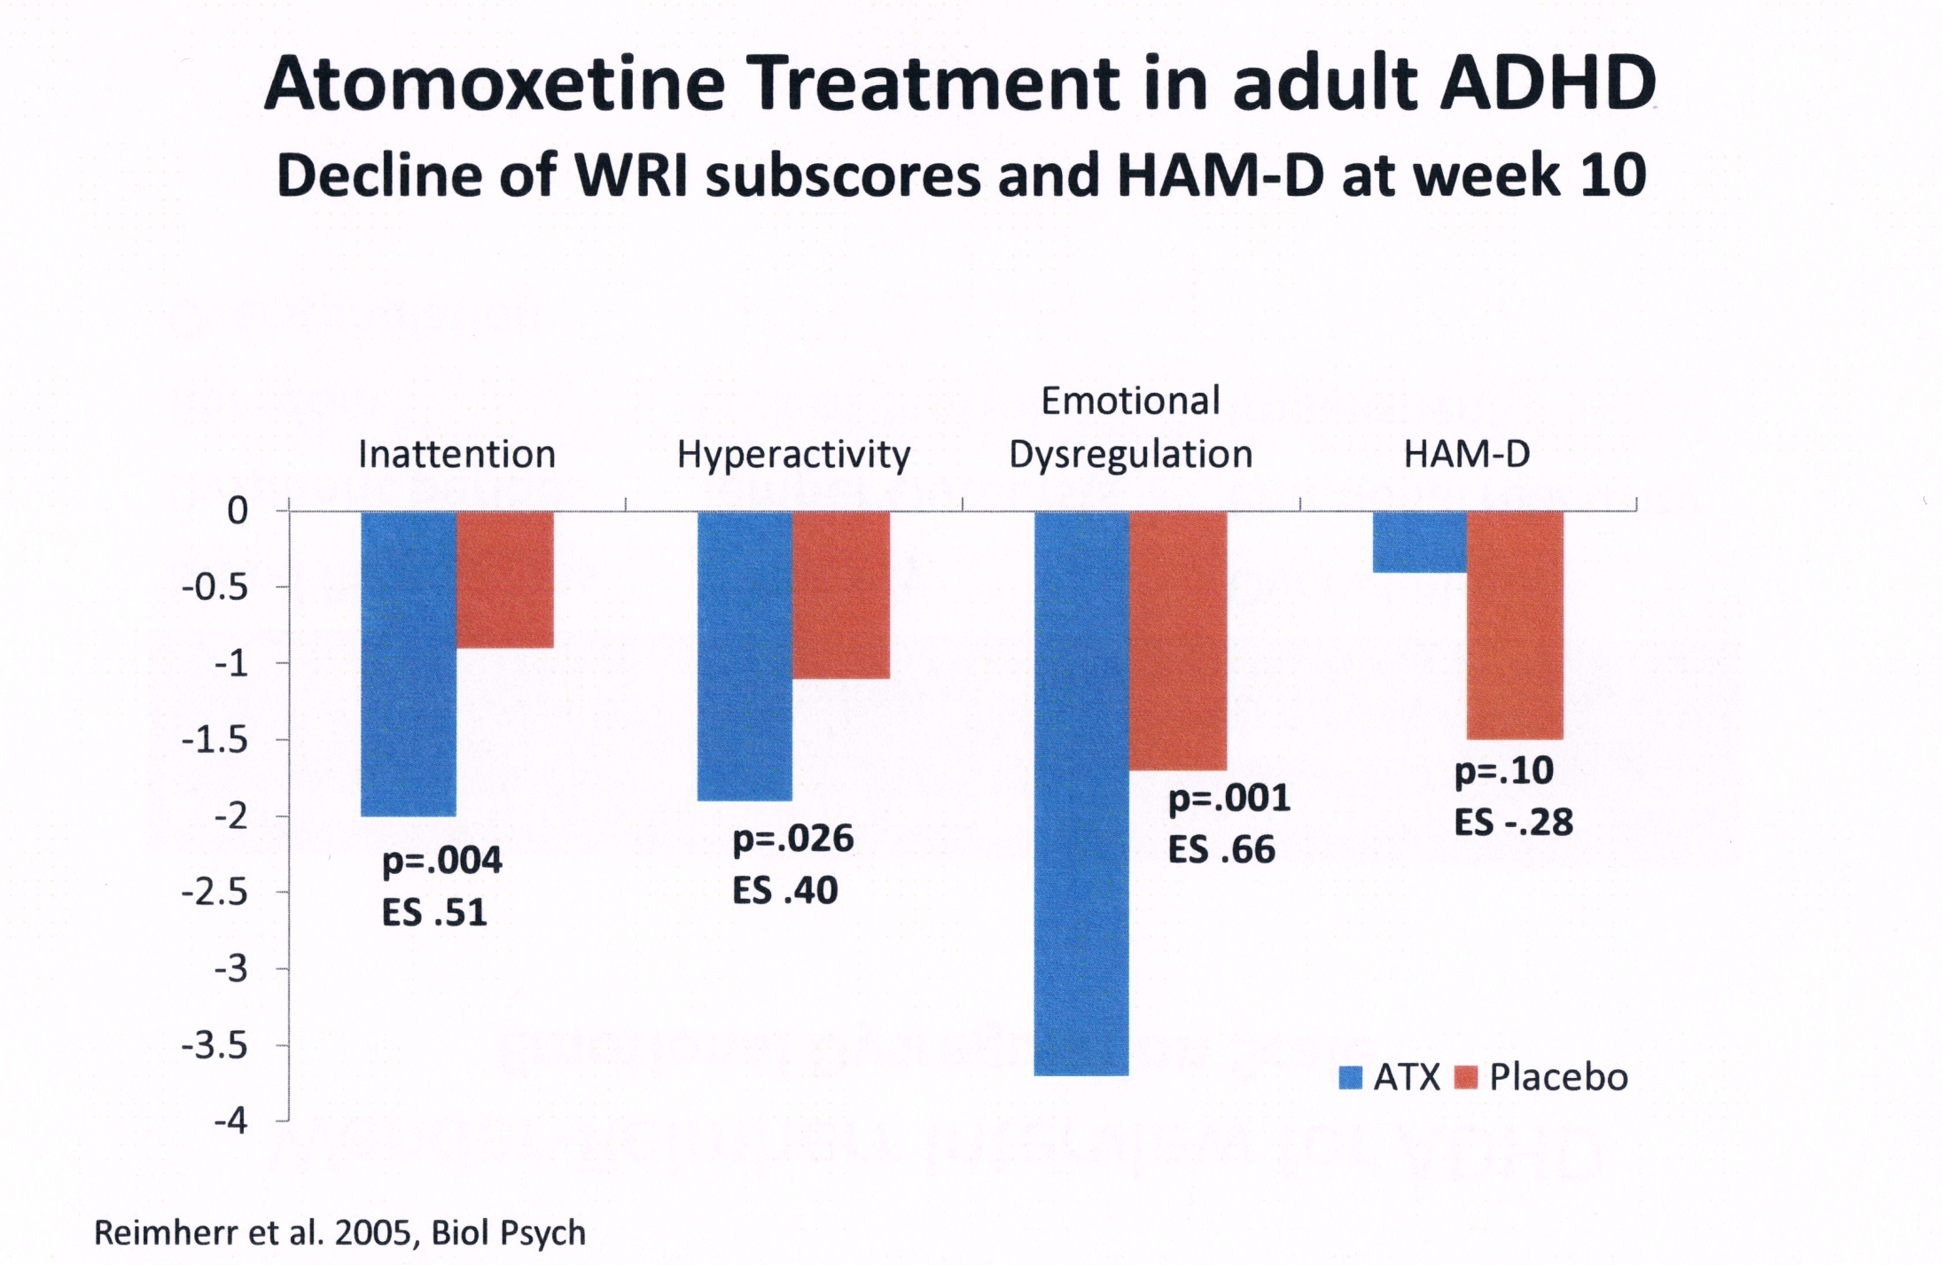

Slide 54
專注力失調藥物 Should not use under the age of 6
Concerta
Strattera
Once daily
Rapid onset
Exaggerate tics
Reduces all symptoms
Well tolerated
Headache (26%)
Loss of appetite (14%)
Insomnia (14%)
Once or Twice daily
Delay onset
non-stimulant
Improves sleep pattern
Well tolerated
Headache (23.8%)
Loss of appetite (7.1%)
Insomnia (6%)

Slide 55
ADHD 治療基因

Slide 56
參考書

Slide 57
Reference Website
www.mentalhealth-pro.comThe Mental Health Professionals
http://www.adhd.org.hk HK Association for AD/HD
www.ha.org.hk/easyEarly Assessment Service for Young People with Early Psychosis
http://www.heephong.orgHeep Hong Society
http://www.hkcpsych.org.hkThe HK College of Psychiatrists
http://www.rcpsych.ac.ukThe Royal College of Psychiatrists
http://www.nimh.nih.govNational Institute of Mental Health
http://www.jmhf.orgJoyful Mental Health Foundation
http://russellbarkley.org Professor Russell Barkley Homepage

